Slide 1
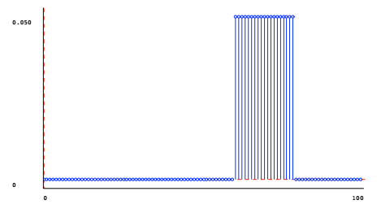
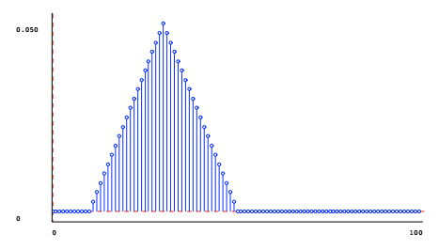

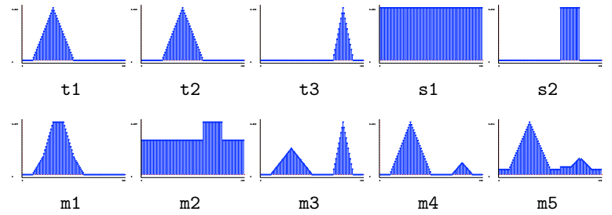
Modeling with distribution
Primitive
Delta
Uniform
Square
Triangle
Mixture distribution
mixing parameter p, with 0 ≤ p ≤ 1

Slide 2
State Estimation

Slide 3
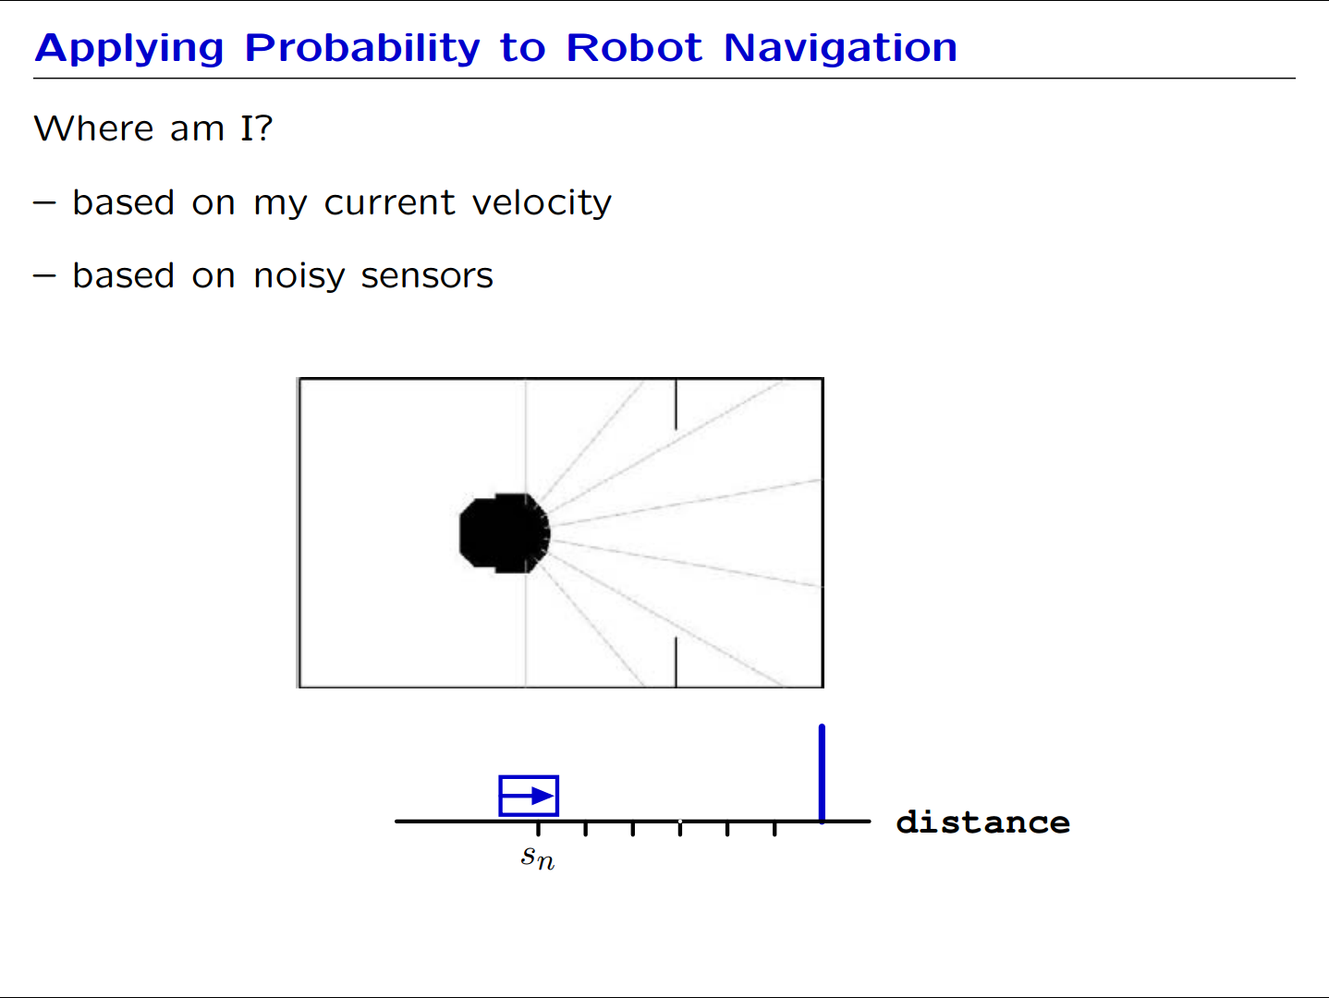

Slide 4
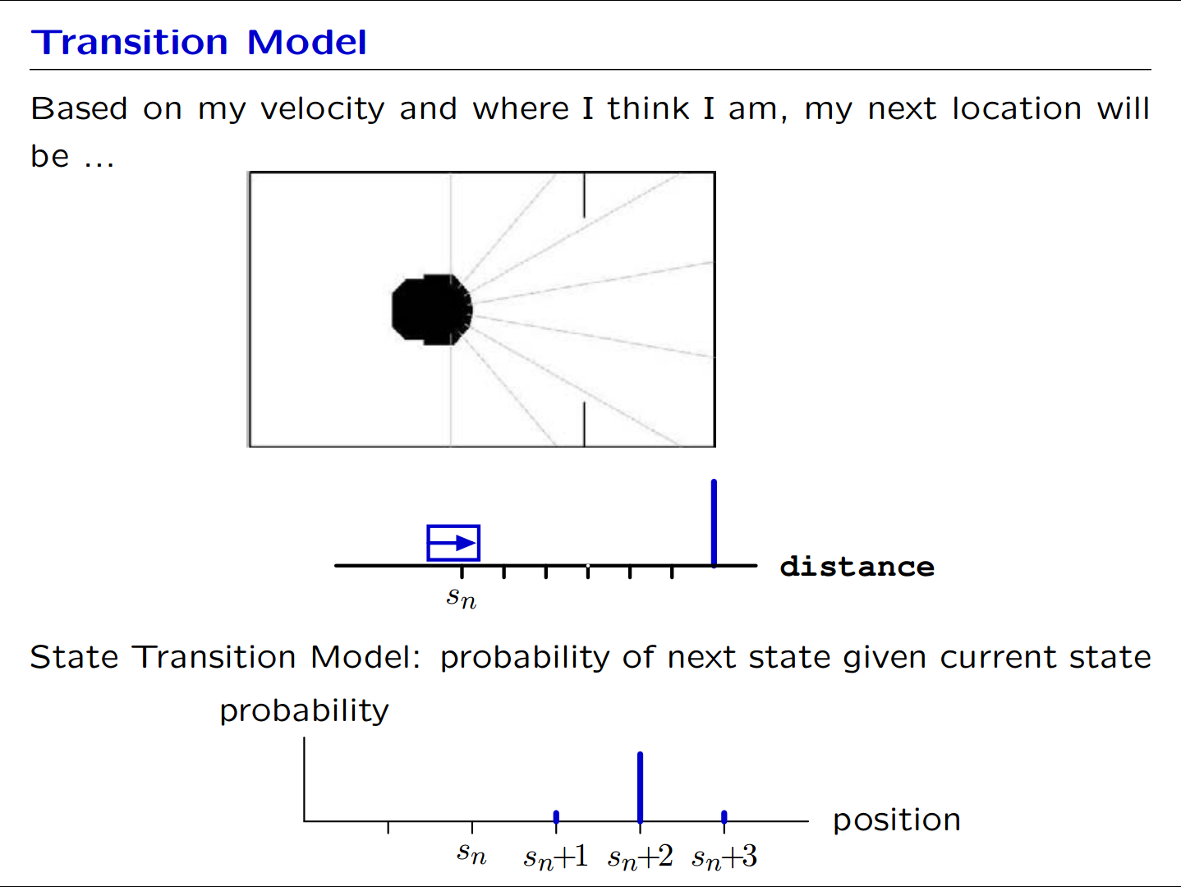

Slide 5
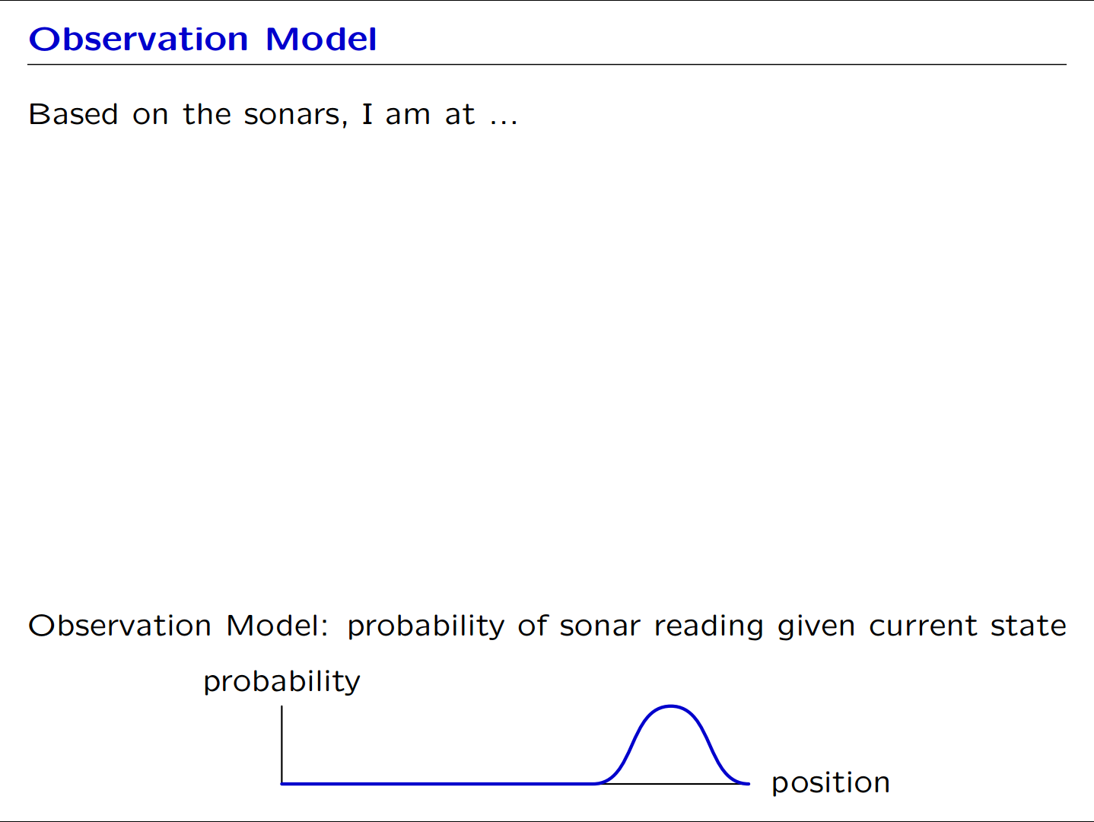

Slide 6
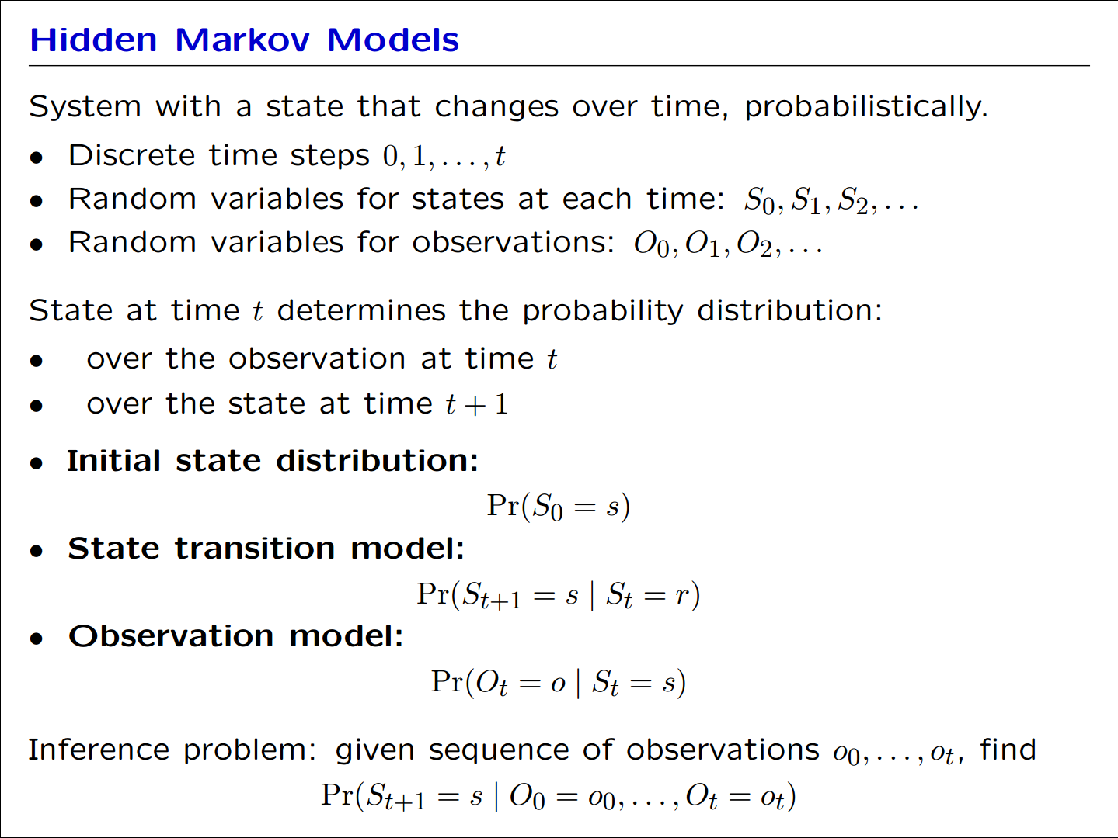
Stochastic State Machines

Slide 7
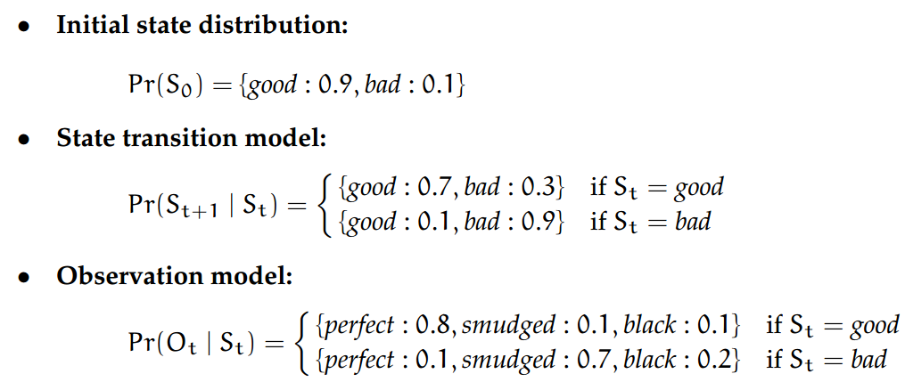
Copy machine example
Copy machine
two possible internal states: good and bad
observations of the copies: perfect, smudged, all black
one input which is to ask it to make a copy
Stochastic state-machine model
Notes:
Smudge [smʌdʒ]

Slide 8






State estimation
Filtering or sequential state estimation
First copy
We print out a page, and it looks perfect
So ?

Slide 9
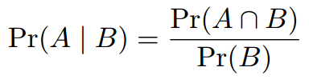
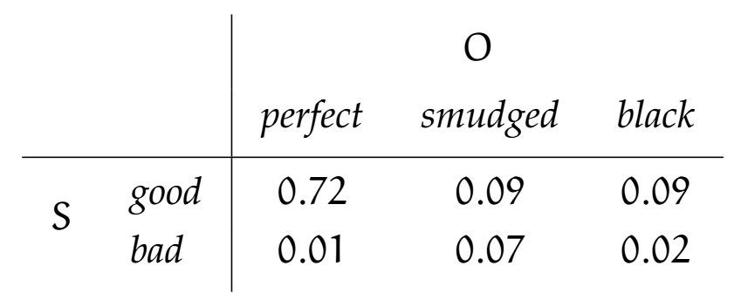
State at time 0
Bayesian reasoning

Slide 10
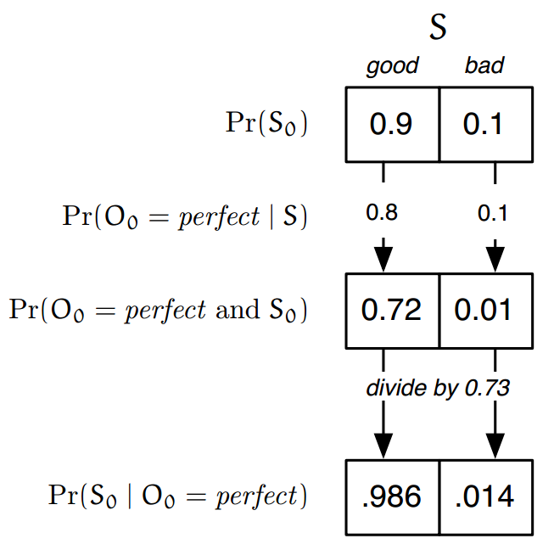
State at time 0
B₀
Observation model
Joint distribution
Bayesian reasoning
B′₀

Slide 11
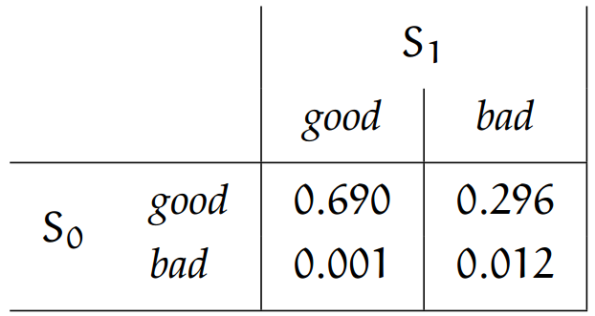
State at time 1
law-of-total-probability
Joint distribution + Marginalizing

Slide 12
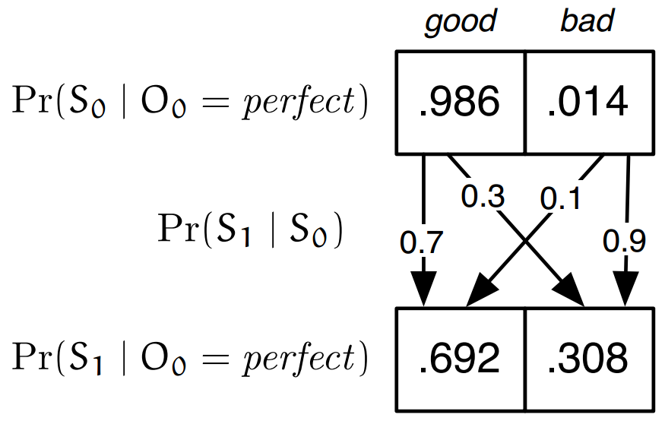
State at time 1
B′₀
Transition model
Law of total probability
B₁

Slide 13

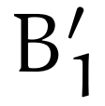

State estimation
Second copy
Print another page, and it’s smudged
So ?

Slide 14
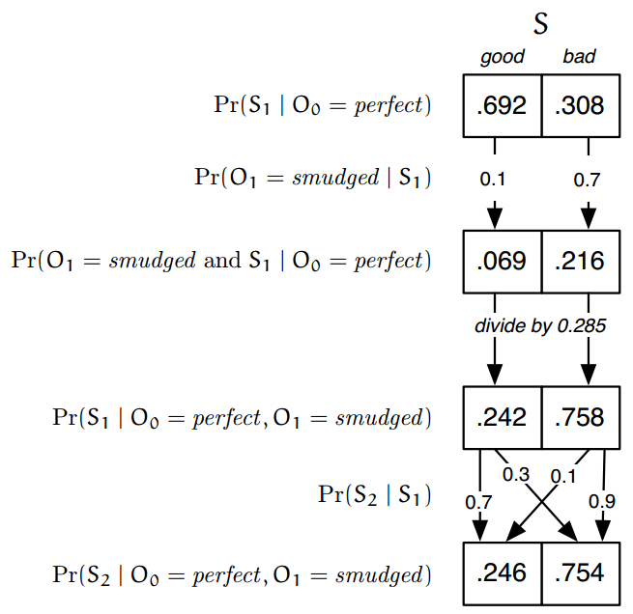
Representation in Python
B₁
B′₁
B₂

Slide 15






General state estimation
Random variables involved
State at each time
Observation at each time
Input at each time
Components of the model
Initial distribution
Observation distribution
Transition distribution

Slide 16

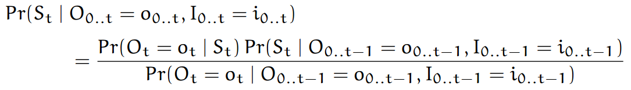
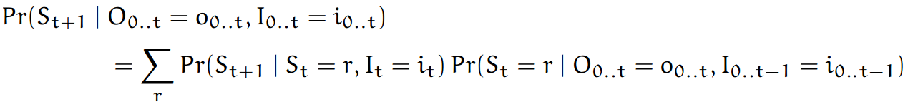
General state estimation
State-update
Assume we have a belief state at time t
Observation update, given
Transition update, given

Slide 17
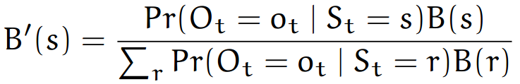
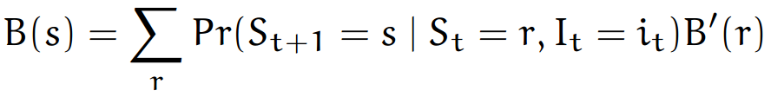
‘recursive’ state estimator
belief at time t
belief after making the observation update
Observation update
Transition update

Slide 18
Representation in Python
Operations on distributions (7.4.6)
Primitive & mixture distribution (7.5)
State estimator (7.8.1)
Take as a state machine
State -- the belief state B
Input -- an (o, i) pair
Output -- a probability distribution
Get the next values
Observation update: an instance of the Bayesian evidence procedure
Transition update: an instance of the law of total probability

Slide 19
Extended reading
Markov chain (马尔科夫链)
Kalman filter (卡尔曼滤波)

